Slide 1
Vortex-Drone Introduction and Tutorial
Sam Jijina
HPArch Research Lab
Georgia Institute of Technology
OAC 2103951

Slide 2
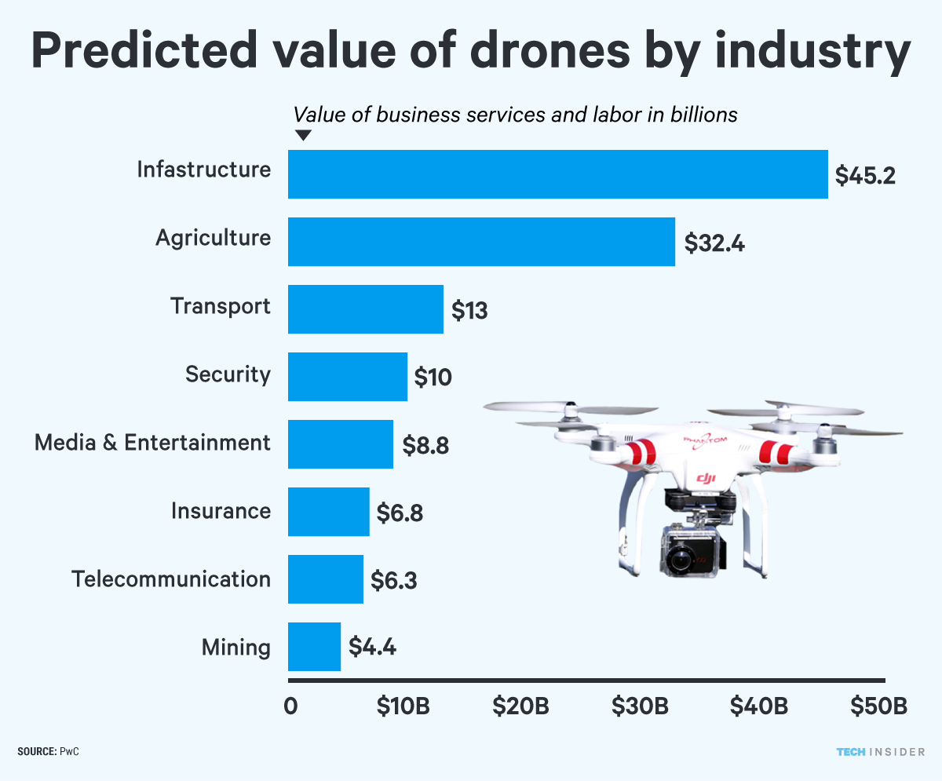
Motivation
Commercial drone industry will reach 805,000 in sales in 2021-2022, a CAGR of 51% ^{[1]}
Increasing use cases of drones from surveying land to emergency services and national security
Open-source flight stack to promote innovation through collaboration
Characterizing underlying architecture and flight stack to achieve high reliability, safety, and performance
Intelligence, Business Insider. “Commercial Unmanned Aerial Vehicle (UAV) Market Analysis – Industry Trends, Forecasts and Companies.” Business Insider, Business Insider, 10 Feb. 2020, www.businessinsider.com/commercial-uav-market-analysis.
Notes:
https://www.businessinsider.com/commercial-uav-market-analysis
https://www.faa.gov/data_research/aviation/aerospace_forecasts/media/Unmanned_Aircraft_Systems.pdf

Slide 3
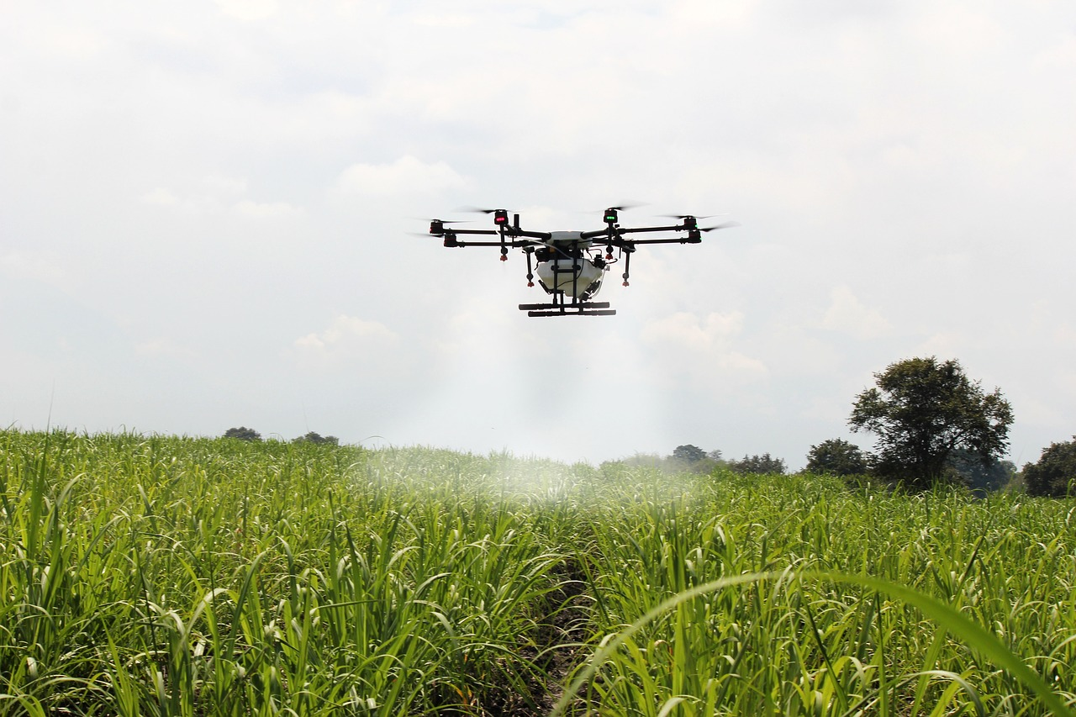
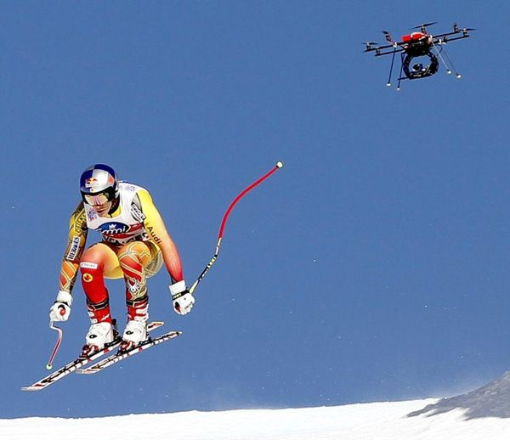
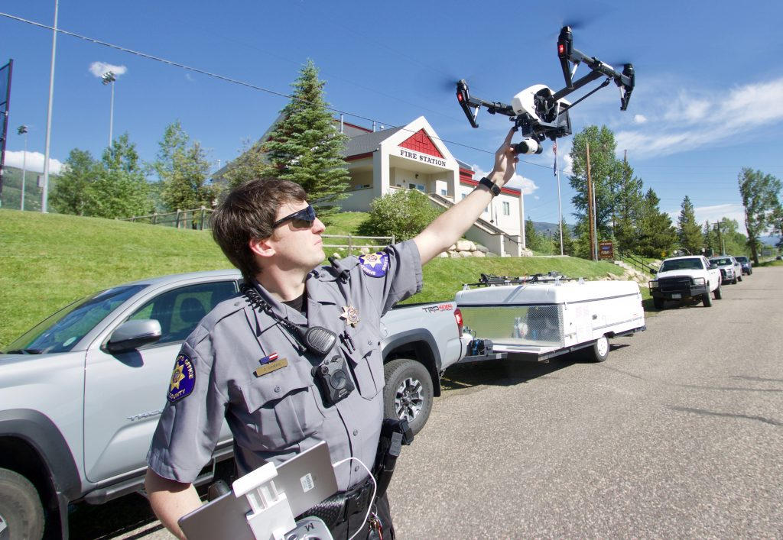
Applications of Drone Technology
Aerial photography
Agriculture
Defense
Emergency services
Geographic mapping
Personal hobby
Search and rescue
Shipping
and many more...
Notes:
https://medium.com/remote-sensing-in-agriculture/how-drone-technology-can-be-leveraged-in-agriculture-54b687c6dc45
https://www.steamboatpilot.com/news/the-sky-is-the-limit-routt-county-invests-in-drone-technology-for-law-enforcement-and-wildfires-as-legal-groups-worry-about-becoming-a-surveillance-society/
http://blog.jammer-store.com/2012/05/police-of-victoria-australia-will-use-flying-spy-drones/

Slide 4
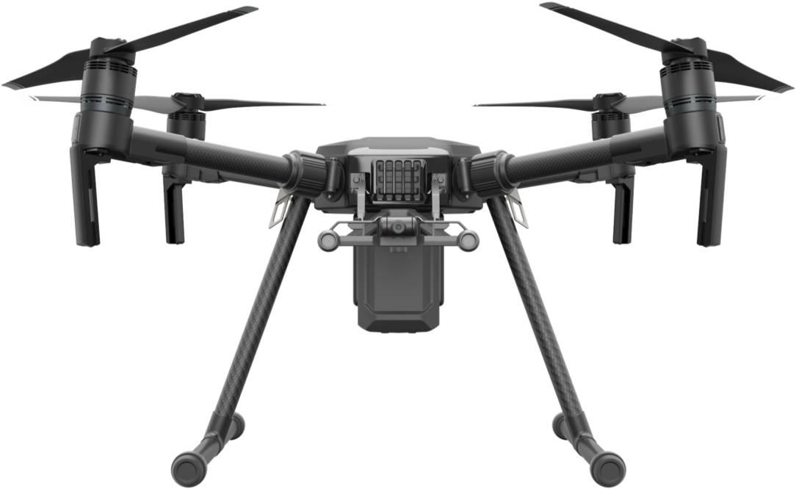
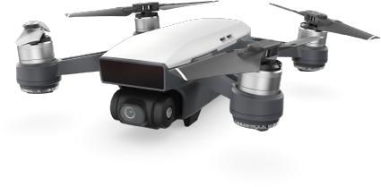
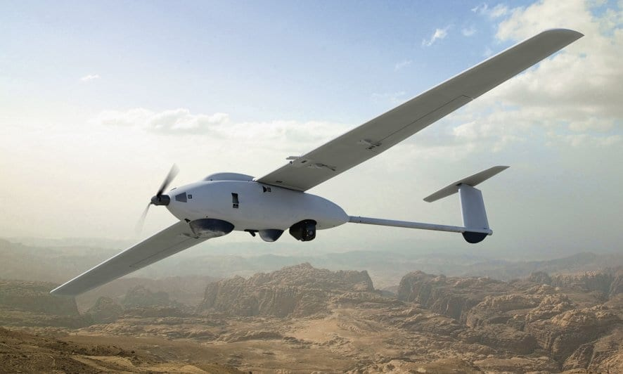
Current Drone Technologies
DJI Commercial Drones ^{[5]}
Matrice Series (customizable and weight carrying configuration)
DJI Personal Drones ^{[7]}
Spark
Mavic Series
Parrot Personal Drones ^{[8]}
Amazon Delivery Drones ^{[6]}
SkyDio Series ^{[9]}
These drones are specialised for tracking moving objects
They heavily rely on Computer Vision and Localisation utilities
Boeing and Lockheed Martin ^{[10], [11]}
Drones are oriented more towards defense sector
High Altitude Long Endurance (HALE)
Stalker XE UAS
Notes:
***add images of current drone tech in the world, background information/ current tech details and their applications
https://www.dji.com/matrice-200-series
https://www.support.com/how-to/how-to-use-the-camera-for-a-dji-spark-drone-11760
Citations for Text (DJI, AMAZON, SKYDIO)

Slide 5
Current Technological Shortcomings
Most drone flight stacks are not open-source
No access to the autopilot code base
Weight carrying capacity limitations
Very difficult to alter hardware due to custom PCBs
Not cost effective for various types of research projects

Slide 6
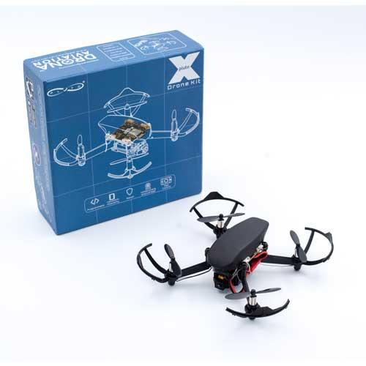
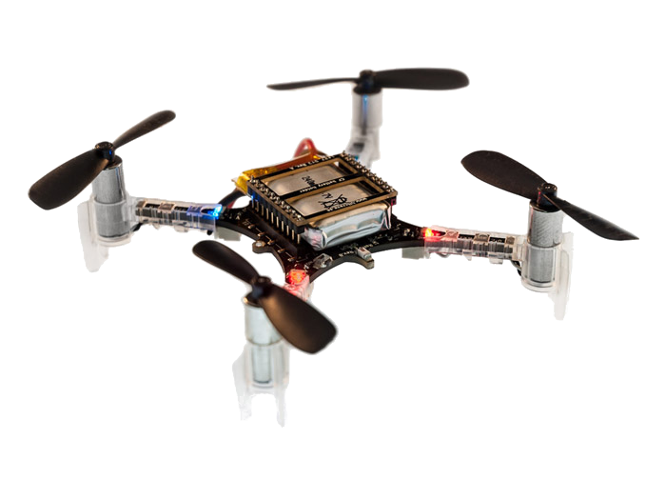
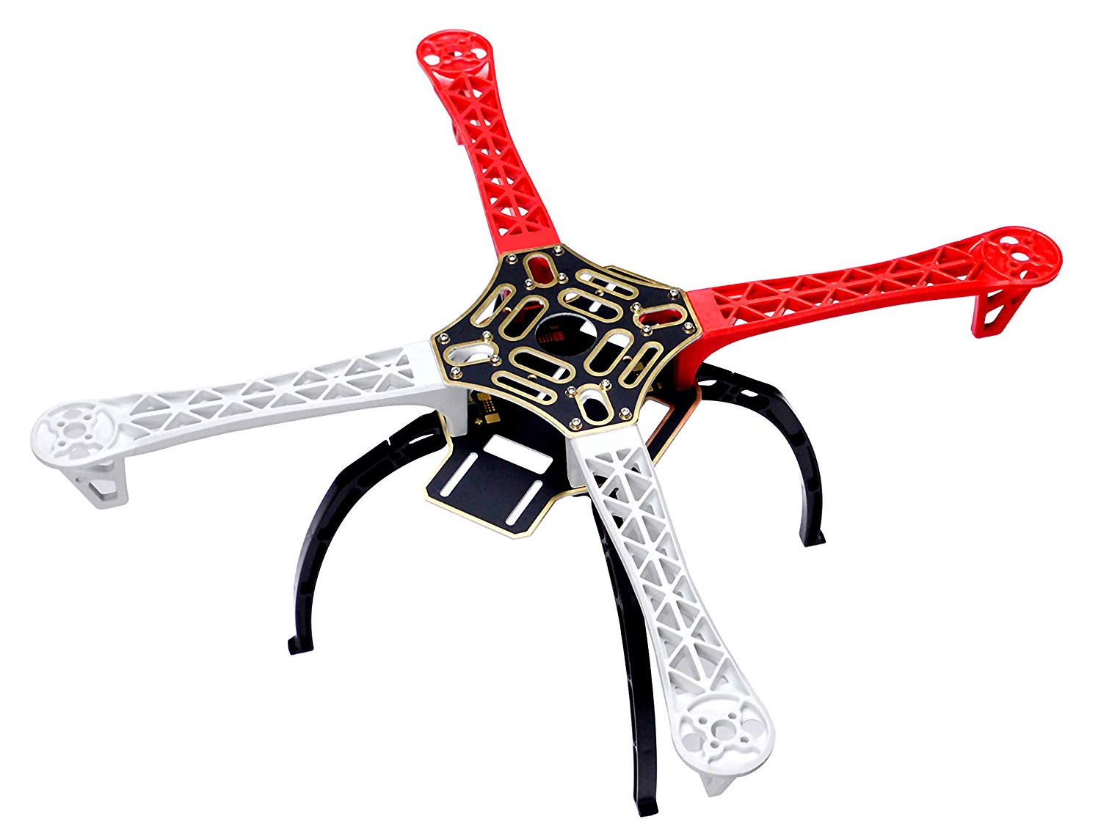
Design Choices
Open-source drones already exist
CrazyFlie ^{[12]}
PlutoX ^{[13]}
BUT…
Limited weight carrying capacity
Limited flight time due to battery capacity
Microcontroller performance limitation
We set up a development platform to allow for more sensors and devices to be added in the future
Camera for SLAM ^{[14]} or OpenCV ^{[15]}
LIDAR
So we decided to use a frame kit
to build a custom drone

Slide 7
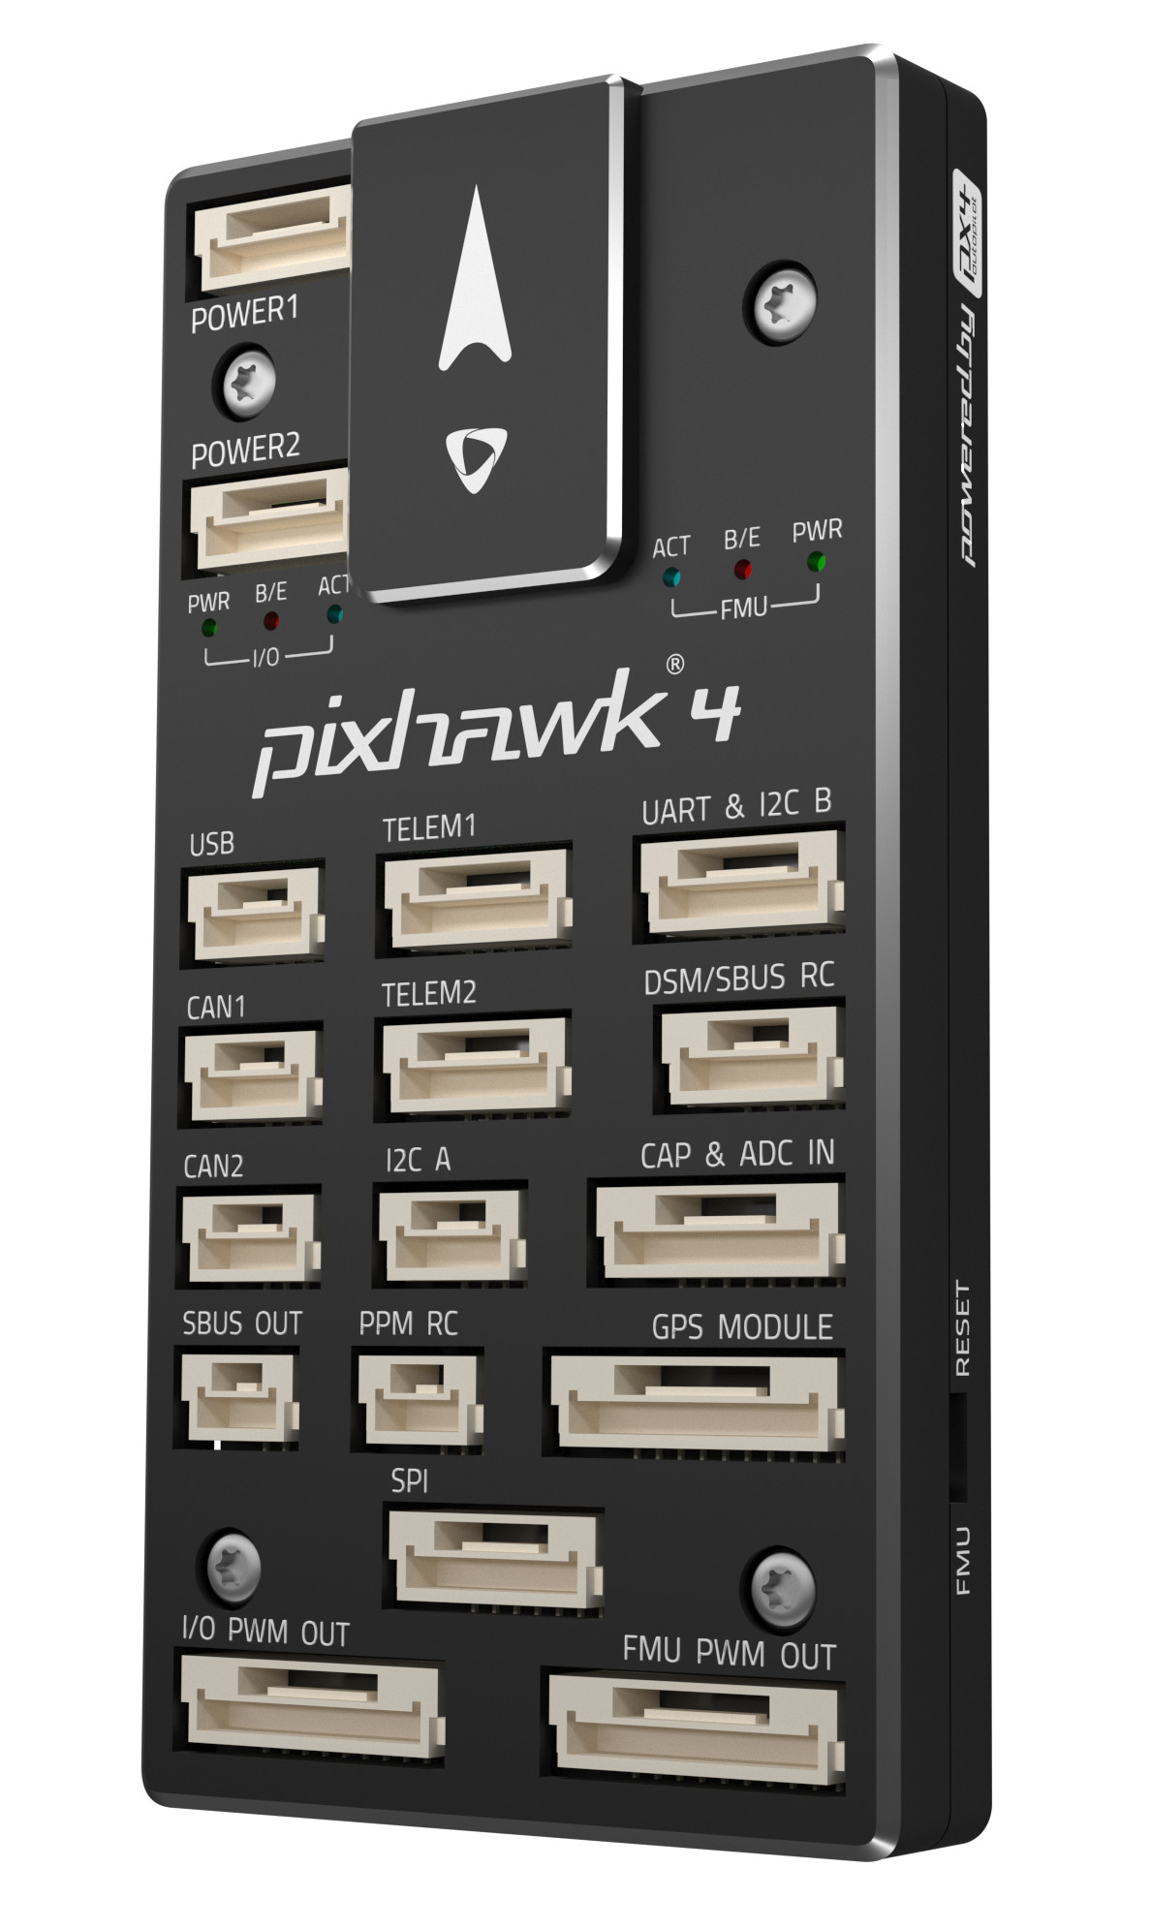
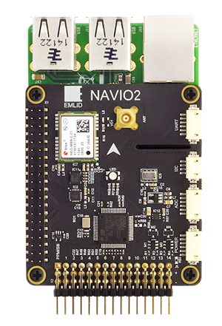
Build Process
Steps:
Component collection and compatibility validation
Motor specification calculations
Dependent on aggregate weight
Weight carrying capacity
Motor power calculations
Choose flight controller
Pixhawk 4 ^{[17]}, Navio2 ^{[16]}, Pixhawk Pro ^{[17]}
Based on drone purpose
Cost analysis
Performance criteria
We needed a low latency flight controller which would work with an on-board computer (Raspberry Pi) ^{[18]}
Notes:
https://www.amazon.com/gp/product/B00N3I9GM4/ref=ppx_yo_dt_b_asin_title_o05_s01?ie=UTF8&psc=1
https://docs.px4.io/v1.9.0/en/flight_controller/pixhawk3_pro.html

Slide 8
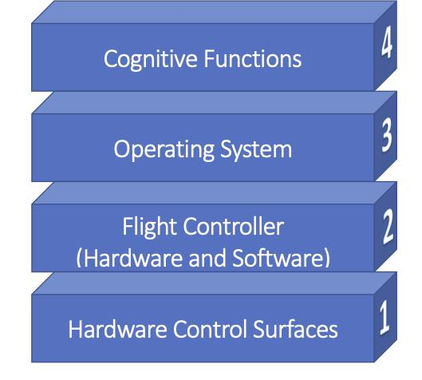


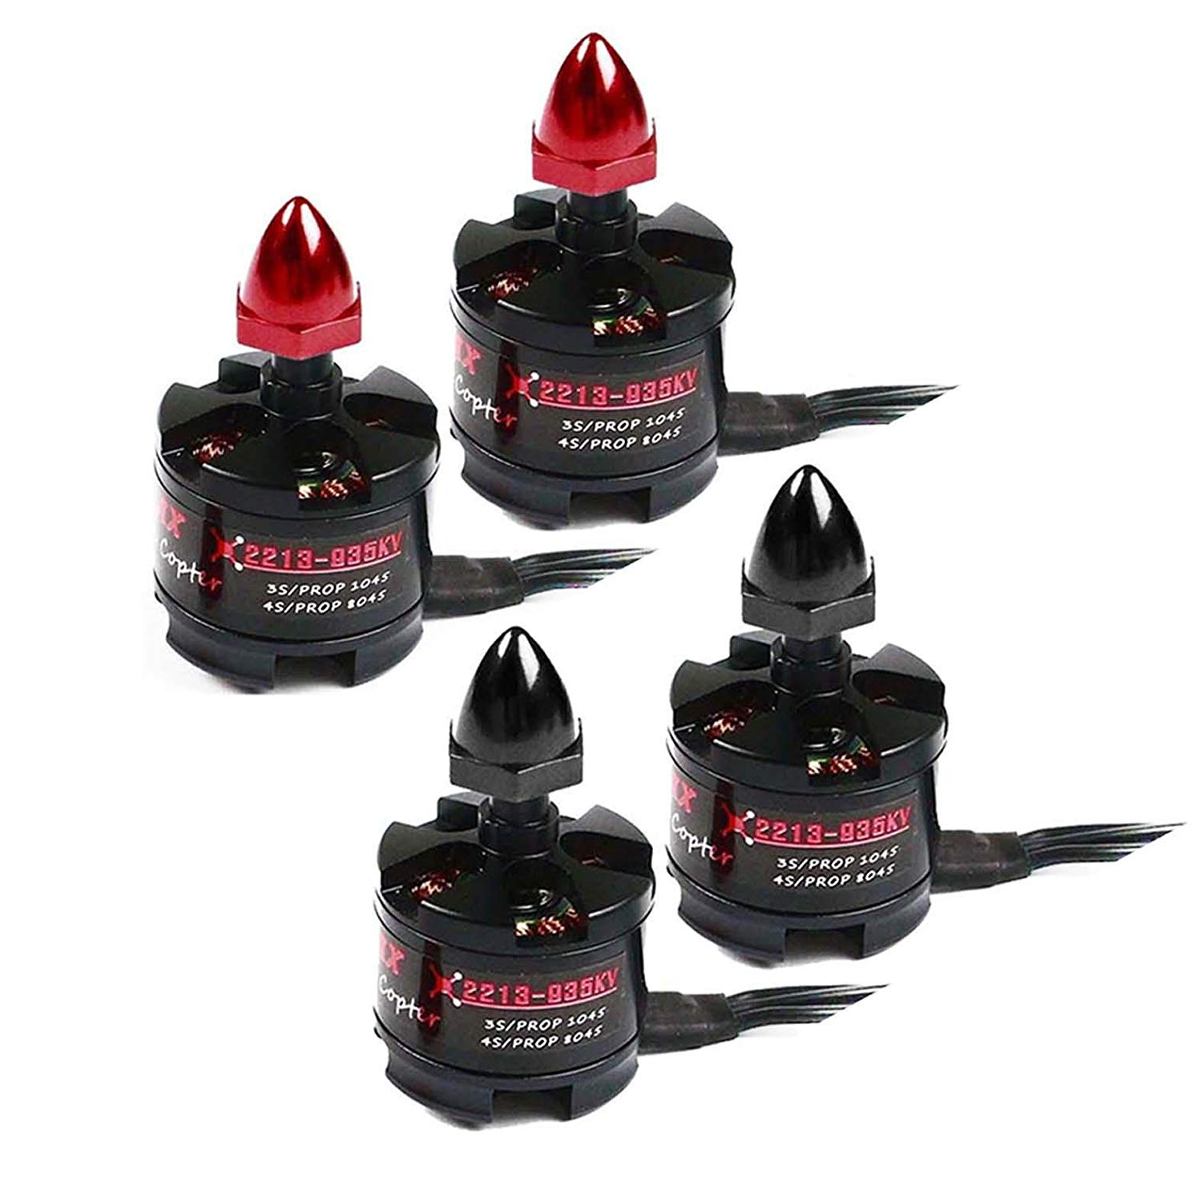
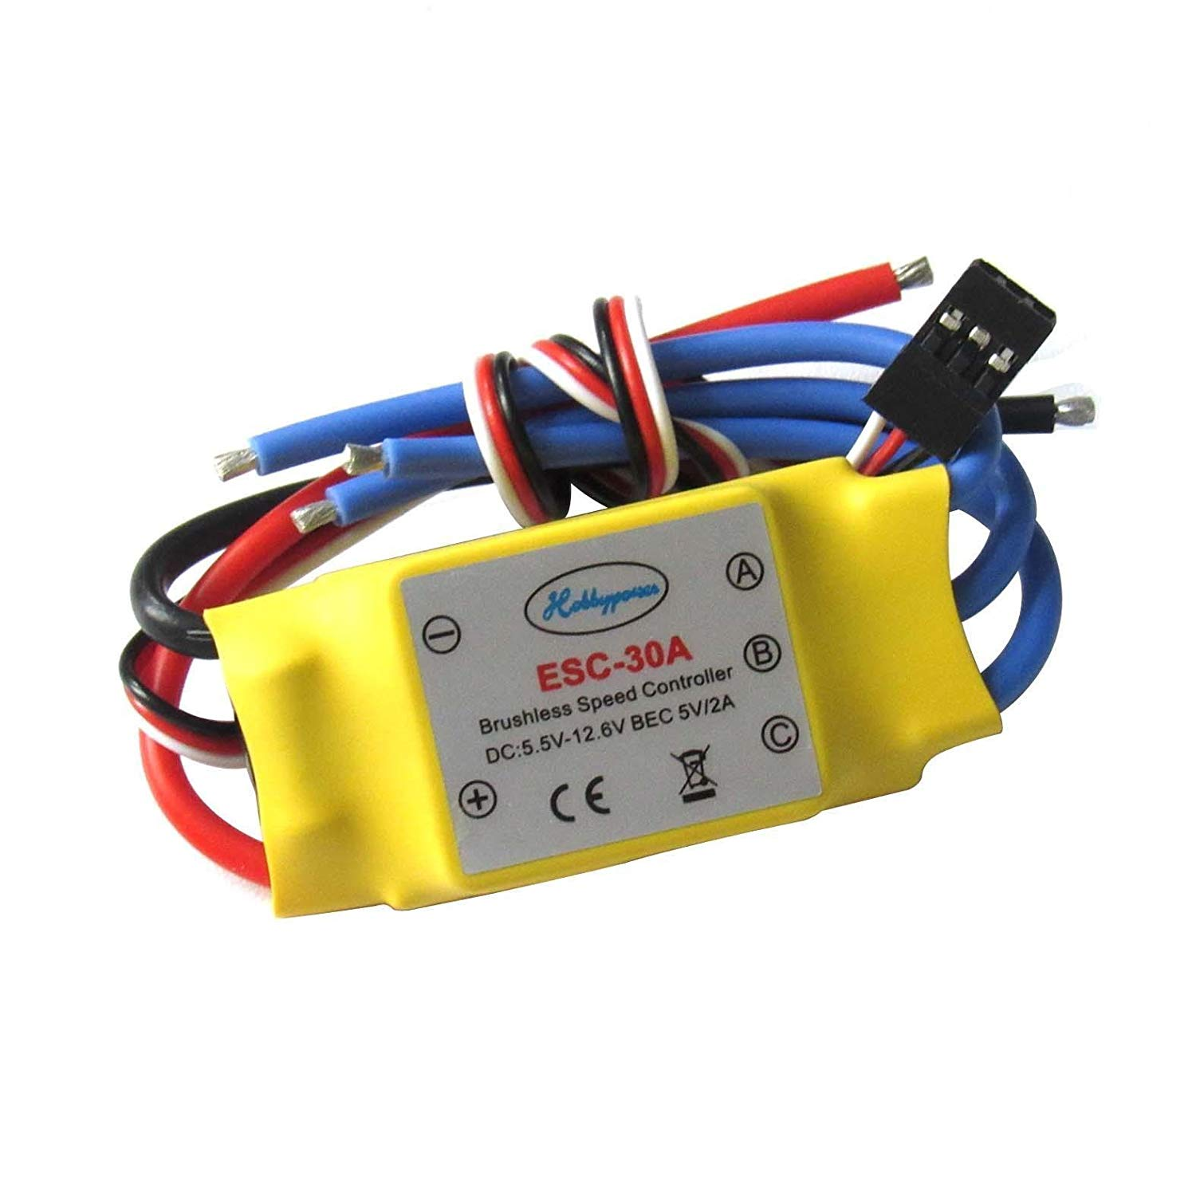
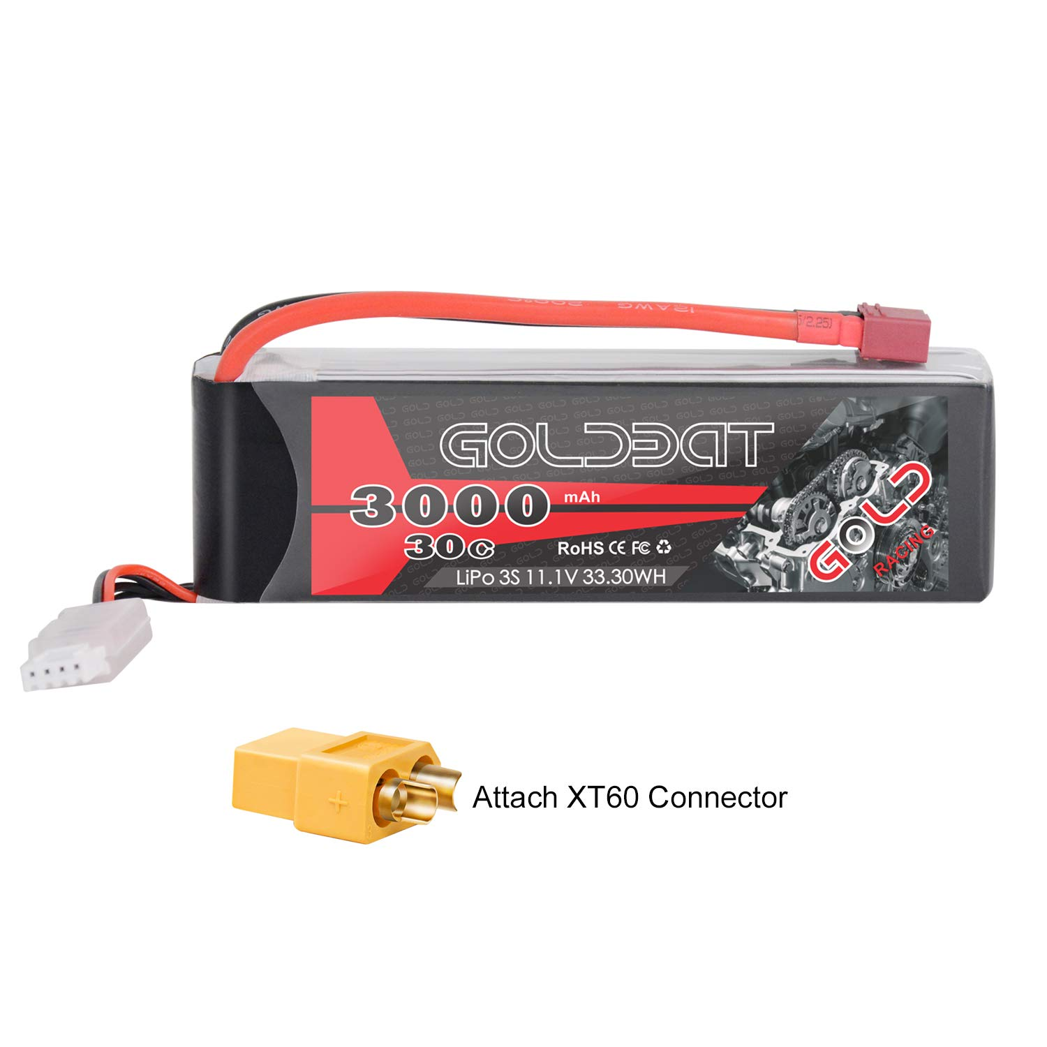
Architecture of Drone Flight Stack
Path Planning and SLAM
Notes:
https://www.amazon.com/gp/product/B00N3I9GM4/ref=ppx_yo_dt_b_asin_title_o05_s01?ie=UTF8&psc=1

Slide 9
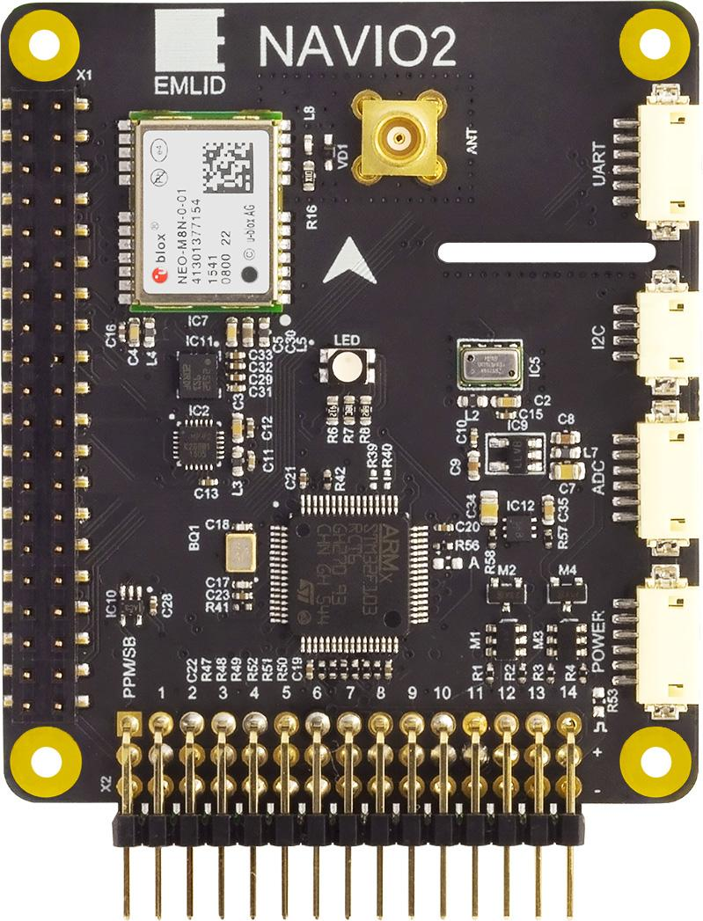
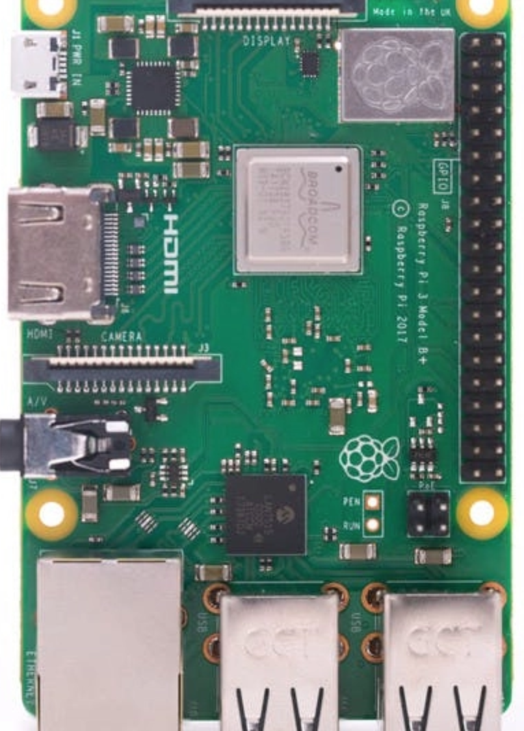
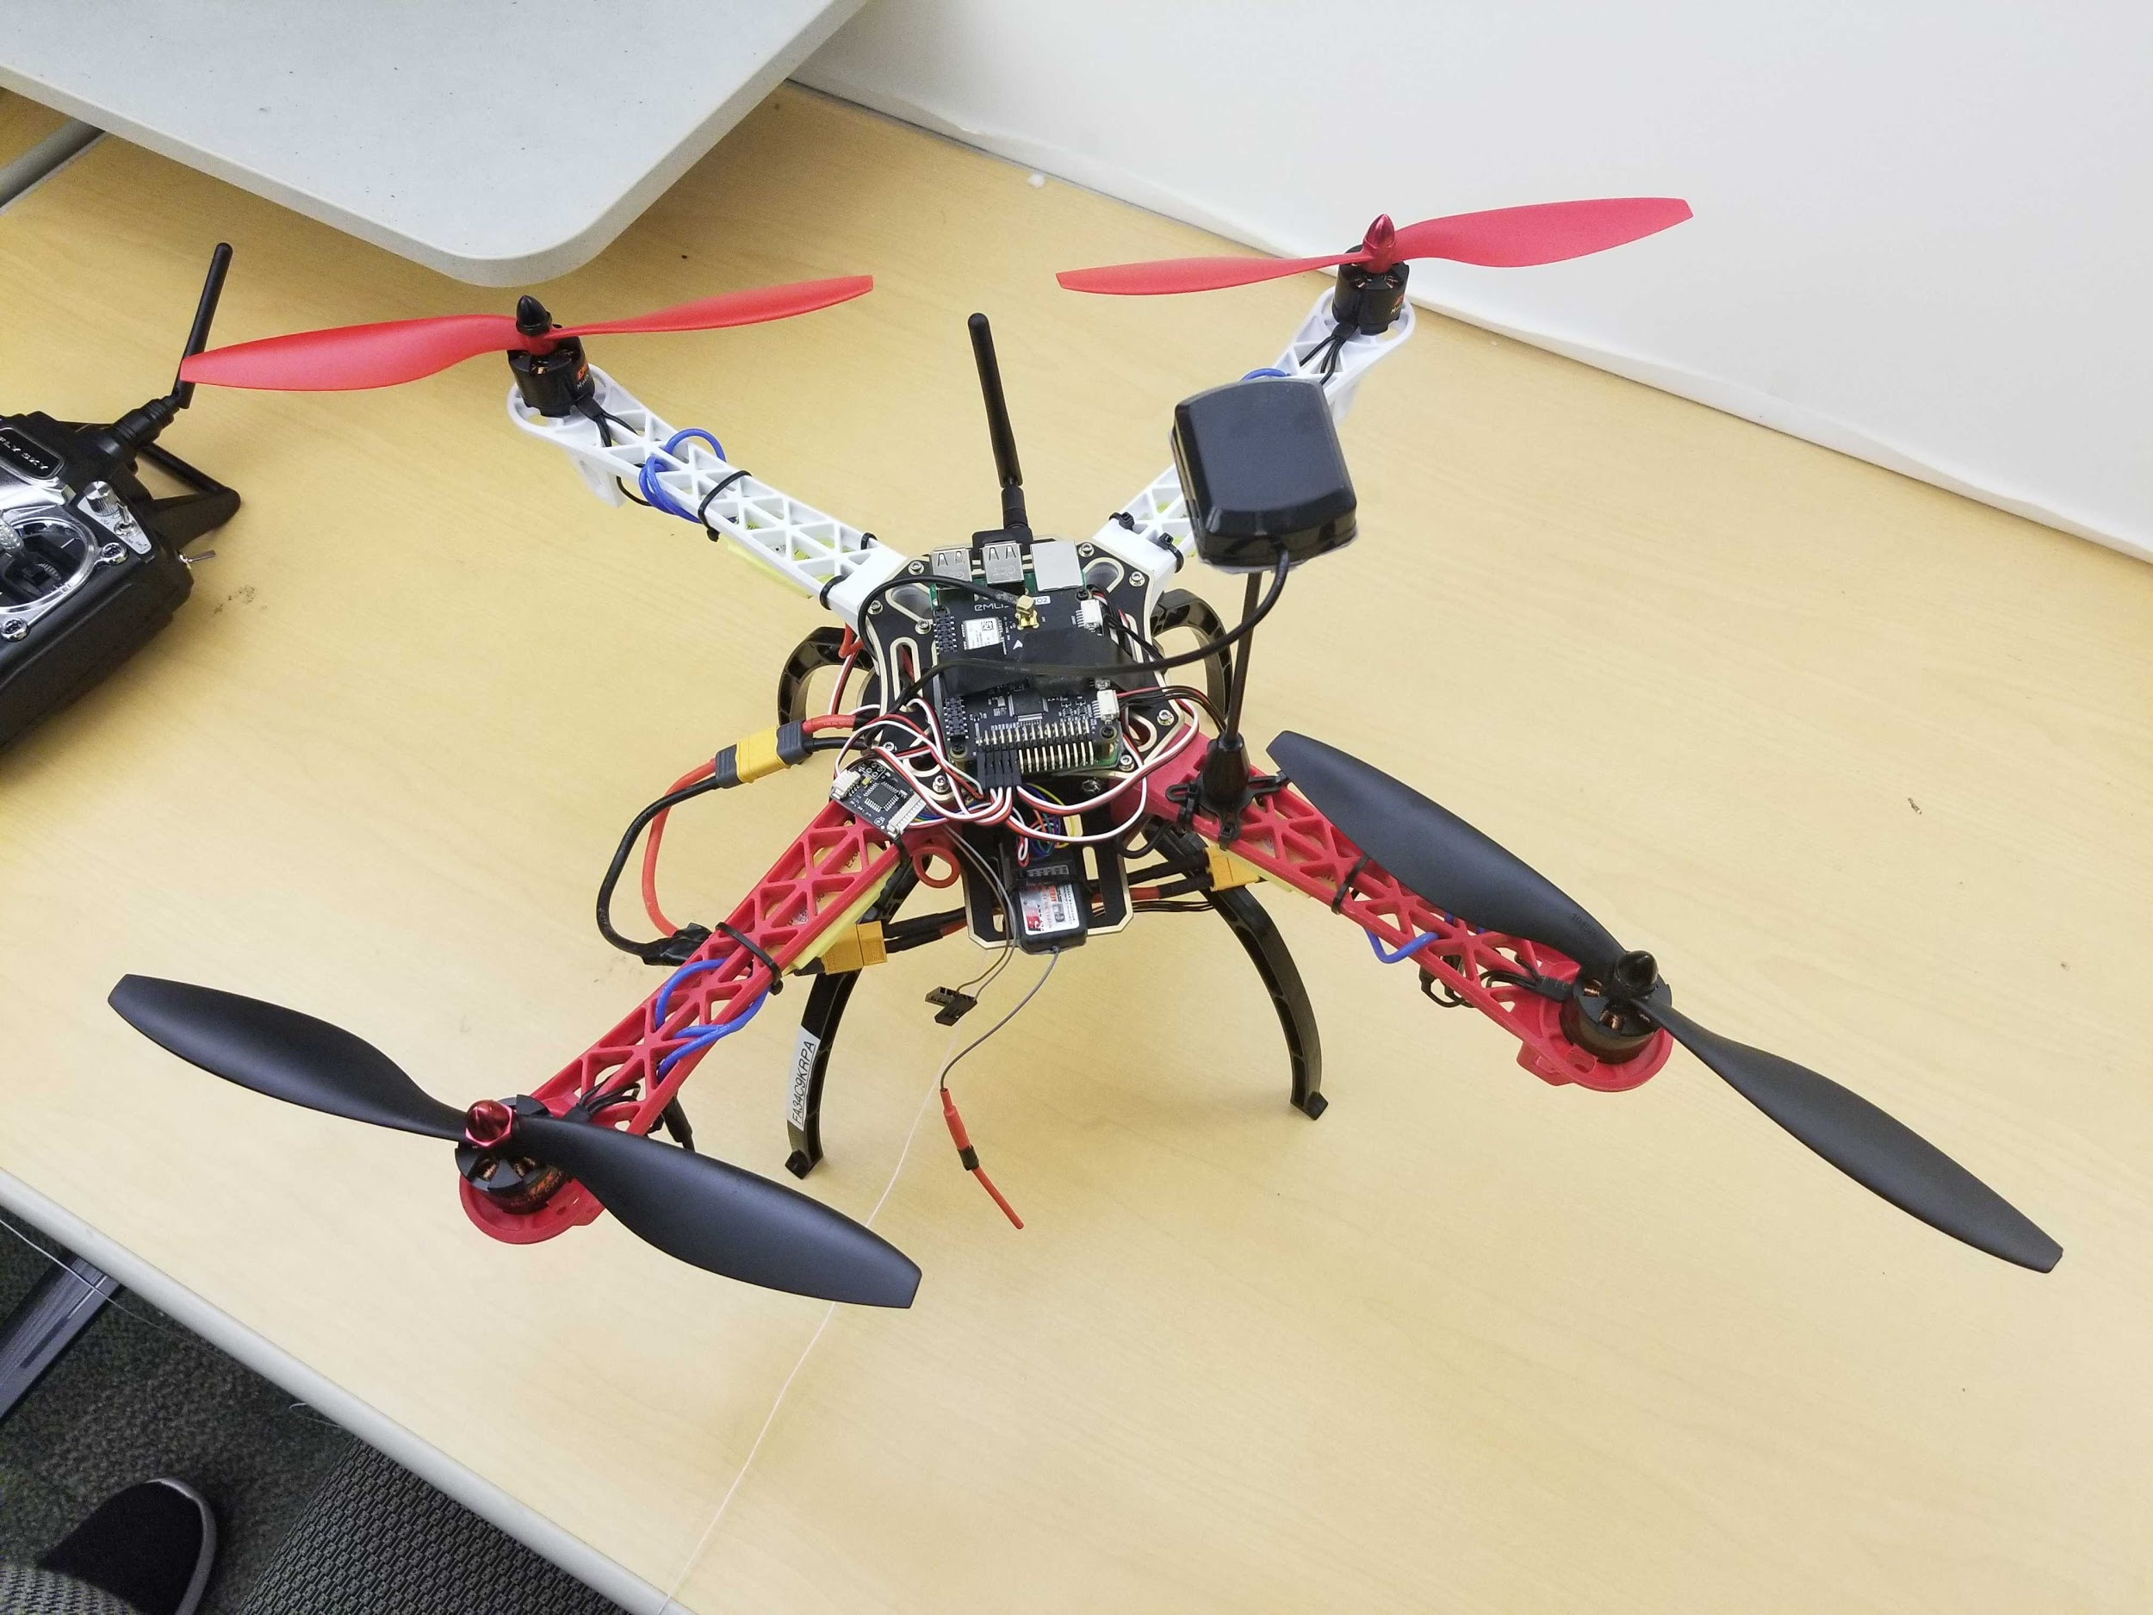
Hardware Overview
Raspberry Pi 3 Model B +
Emlid Navio2 HAT for Pi
ESCs (Electronic Speed Control)
935KV motors
GPS/GLONASS receiver
3000 mAh 3S LiPo battery
915 MHz Ground-to-Air Telemetry communication
Features of Navio2:
Dual IMU
Triple redundant power supply
High resolution barometer

Slide 10
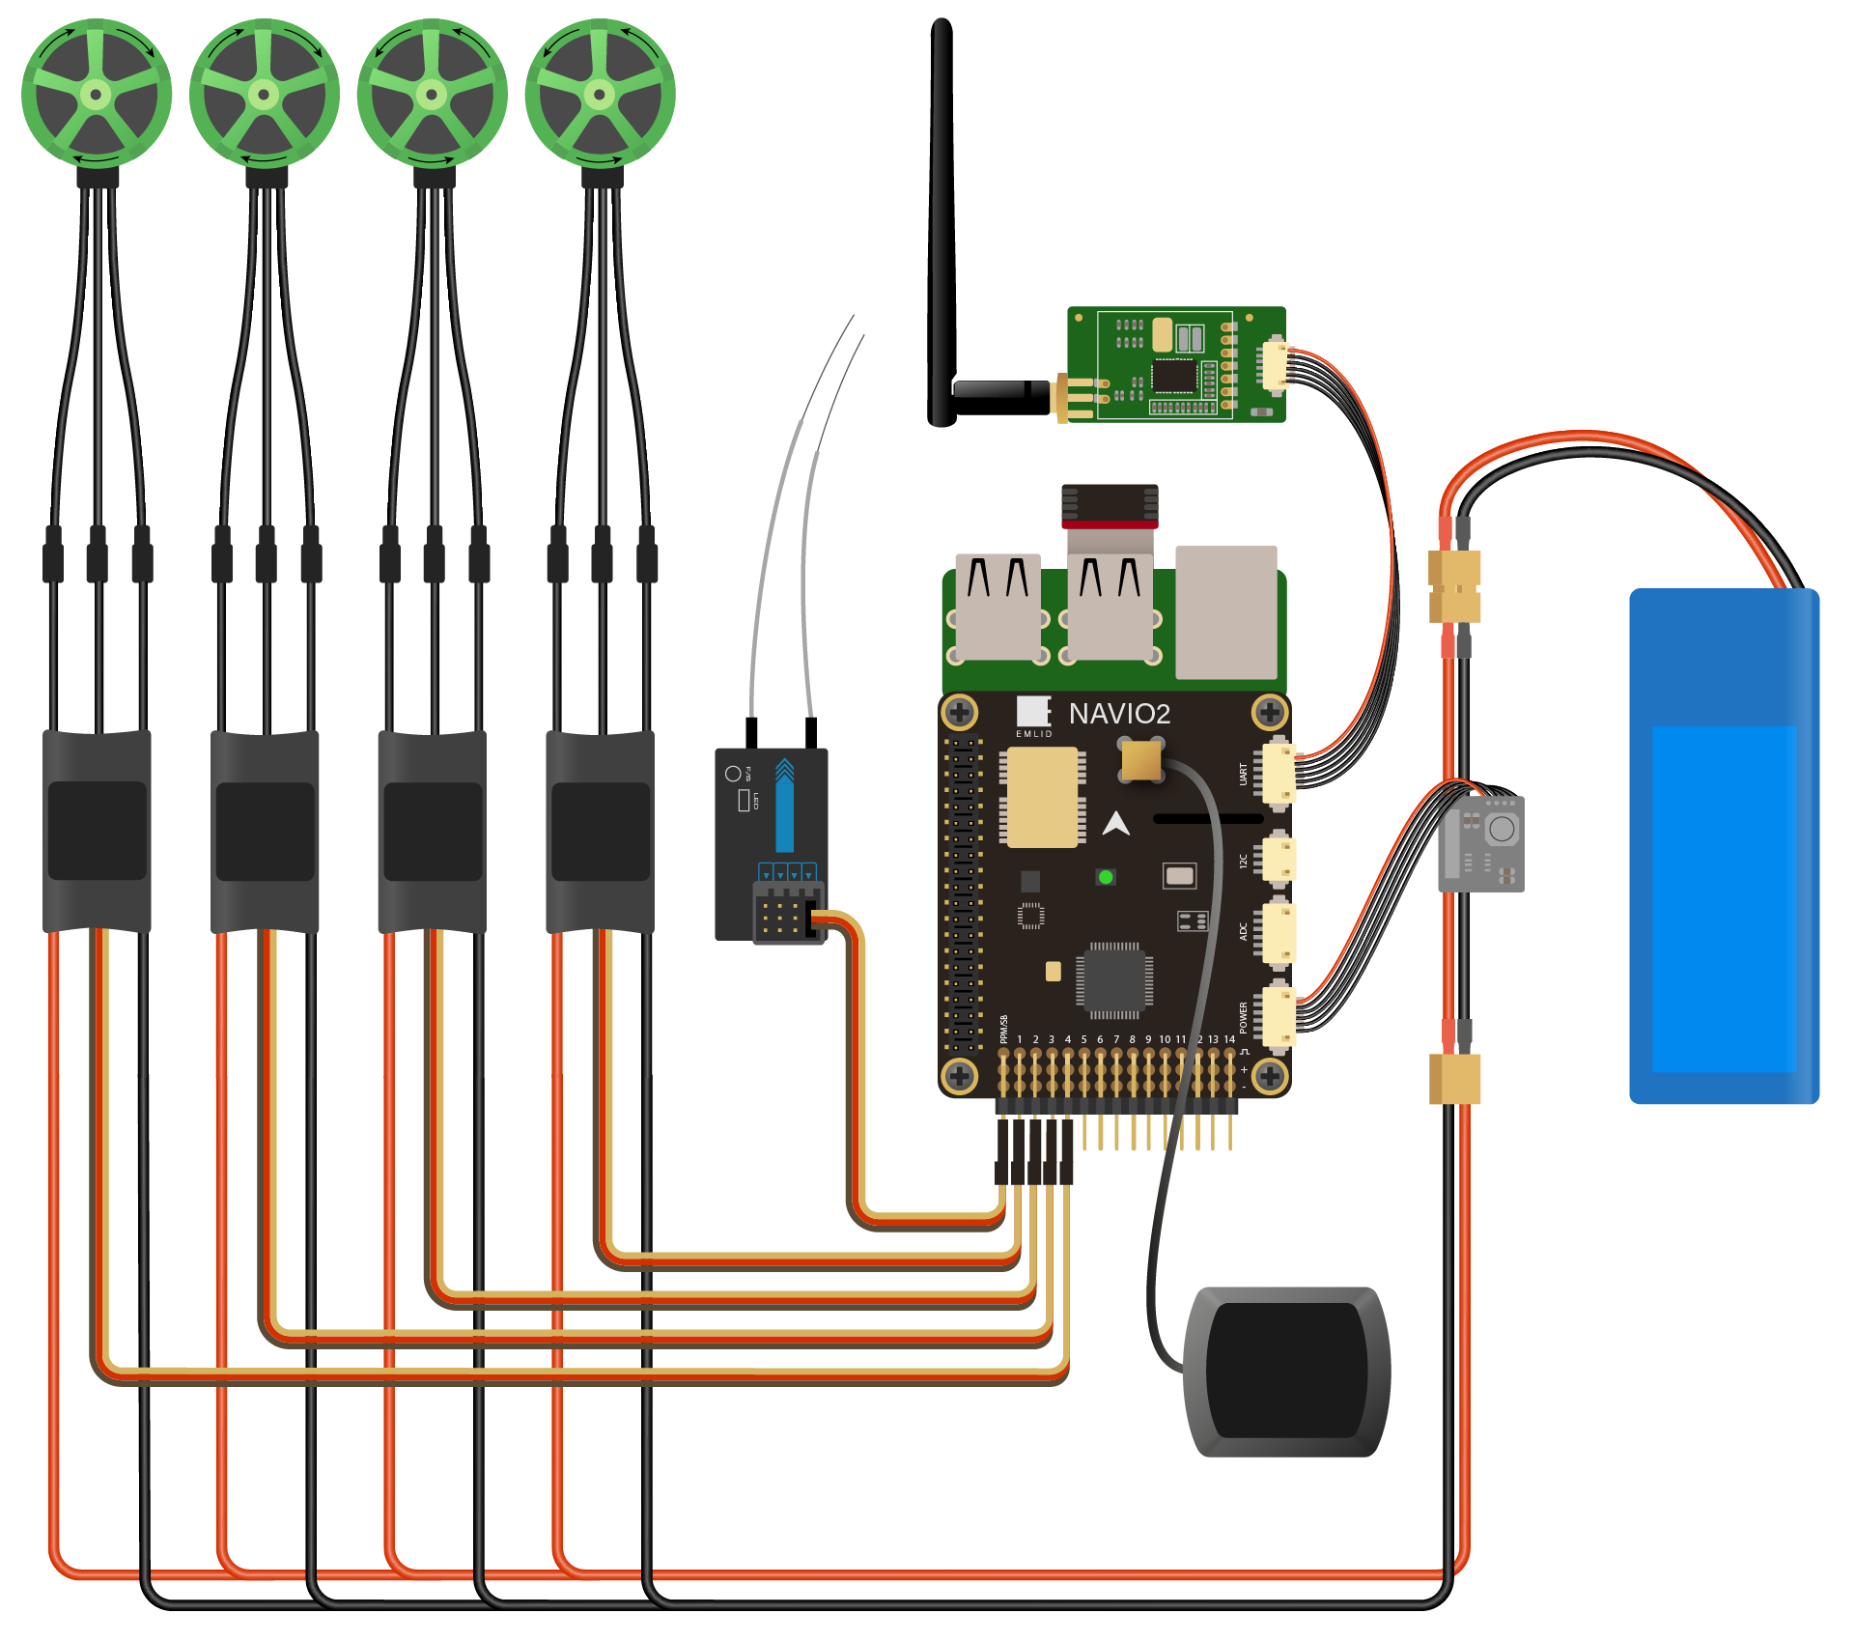
Navio2 HAT Setup
915 MHz Telemetry
Motors
ESCs
Battery
PPM
Encoder
GPS Antenna
Notes:
how we built the drone will be discussed here, Why did you made choices for your current drone (HW, SW, Battery)
https://www.amazon.com/gp/product/B00N3I9GM4/ref=ppx_yo_dt_b_asin_title_o05_s01?ie=UTF8&psc=1
https://docs.px4.io/v1.9.0/en/flight_controller/pixhawk3_pro.html

Slide 11
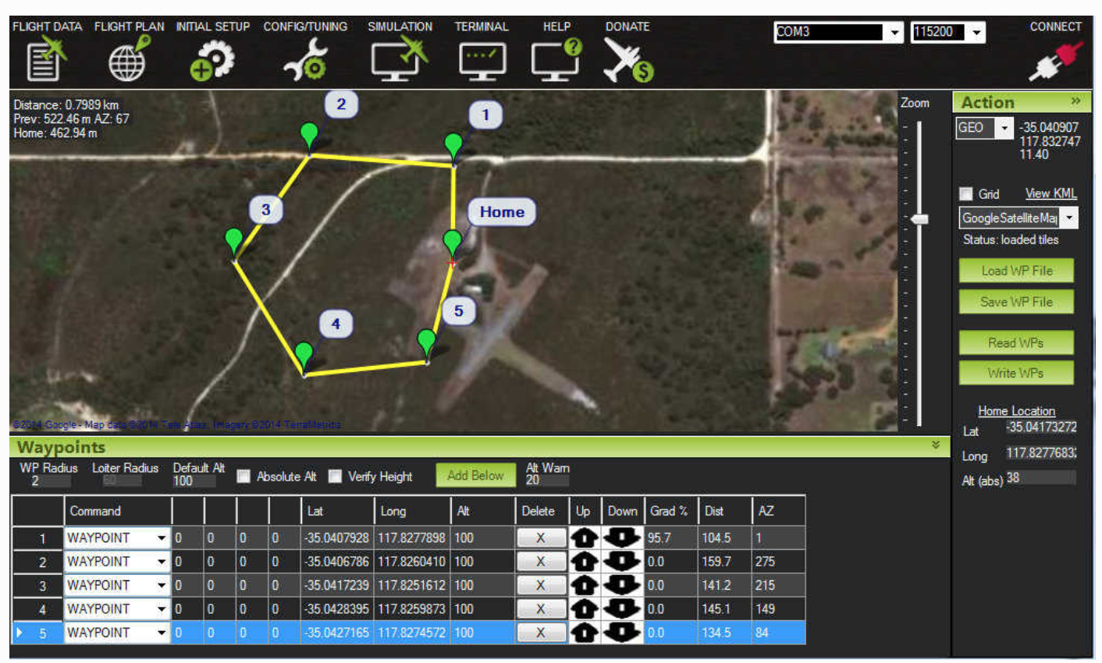
Flight Controller - GCS
Two types of software:
Ground Control Station
Autopilot firmware
Ground Control Station (GCS)
Executes from laptop
Real-time data (altitude, speed, location, battery)
Telemetry communication
Remote commands to override erroneous behavior
Most popular GCS is MissionPlanner ^{[20]}
Open-source
Actively maintained

Slide 12
Flight Controller - Autopilot
ArduCopter (fork of ArduPilot) ^{[21]}
Executes on board the drone
Interfacing between hardware and flight code
Autonomous flight capabilities
Flight modes (Guided, Auto, Acro)
Sensor polling and attribute actuation

Slide 13

Flight Controller – Comms
MAVLink ^{[22]}
Micro Air Vehicle Link
Data packet protocol which enables standardized communication between multiple drones
Issuing commands to a drone
DroneKit API ^{[23]}
Python and C++ APIs to issue flight commands easily
Converts commands to MAVLink protocol
Enables use of Python AI libraries with drone

Slide 14
Drone Operating System
Real Time Operating System (RTOS)
RTOSs are used in time critical applications
Popular in robotics
Minimal, if any, latency in response
Kernel tasks can be pre-empted
Most fully supported RTOSs are not open-source
We had the choice of using Linux ^{[25]} or Robot Operating System (ROS) ^{[24]}
ROS is a specialized OS for robotics
Due to the availability of community support and documentation, we decided to use Linux
PREEMPT_RT patch

Slide 15
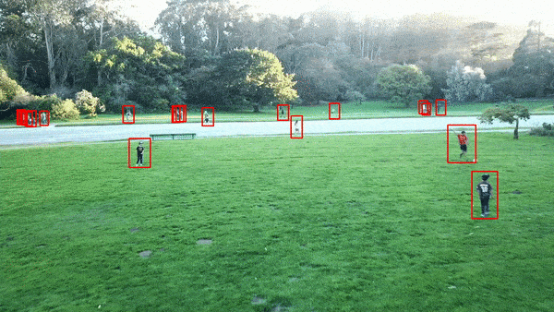
General UAV Task Outline
Capture images
Various image sensors
Buffer video feed
Run computations on images
3D Reconstruction
Feature detection
Collision avoidance
Communicate data and results
Distributed workload
Different communication technologies
Communicate tasks time vary significantly
Dependencies exist between the tasks
DroneEye
(Photo: DSC IITP)
Notes:
A drone’s workload in the aforementioned applications, usually is split between capture, compute, and communicate subtasks.
There can be many dependencies between those tasks. But for a given workload, neither the capture task nor the compute task is flexible in terms of time needed to completion. However, the communicate task’s time can vary quite significantly and hence careful choice of communication technology is important. The upcoming millimeter wave technology offers great promise in this regard.

Slide 16
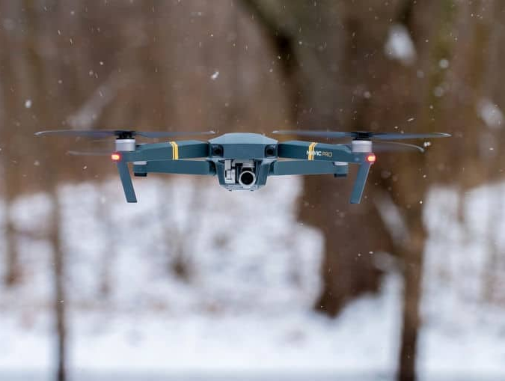
Flight Testing Methods
Manual Flying and Testing
Weather dependent
Battery limitation
Approval Process
Simulations
Software in the Loop (SITL)
Hardware in the Loop (HITL)
SITL simulations used to test flight code
ArduCopter natively compiles for SITL simulation
Less system resource heavy
Microsoft AirSim ^{[27]} for HITL simulation
Open-source
System resource heavy
Provides environment simulation (neighborhood, city)
Notes:
https://tipsfordrones.com/can-drones-fly-in-rain/

Slide 17
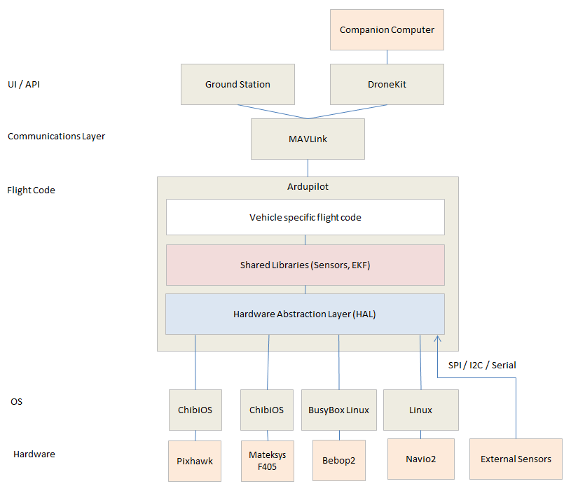
ArduPilot codebase
Vehicle code
Copter, Plane
Sub, etc.
Shared libraries
Sensors
GPS, PID, EKF
Hardware Abstraction Layer
Tools
Sims
Auto-test
Logging
Code Structure (Photo: ArduPilot org)

Slide 18
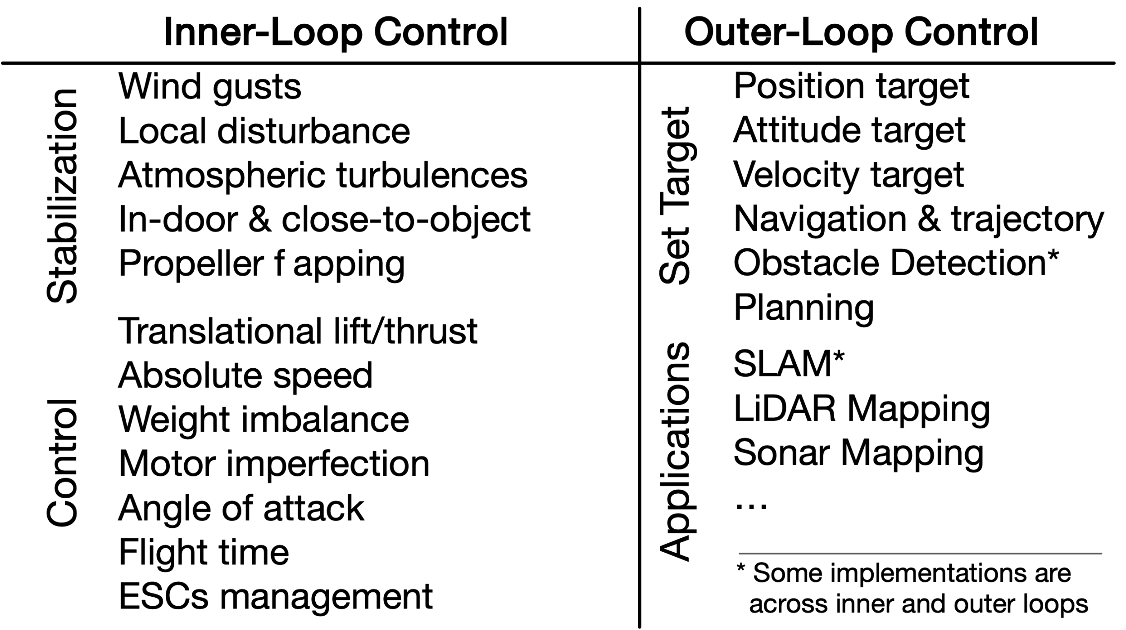
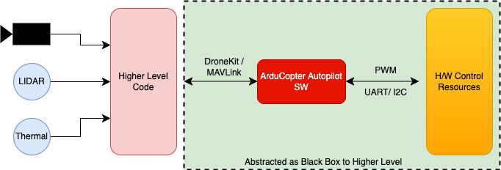
ArduCopter
Interface between higher level code and H/W
Handles inner-loop control (flight attitude, motor imperfection, GPS sync)
Main flight “brains” of the drone
Flight algorithms
Sensor fusion

Slide 19
SITL Simulation Steps
System Requirements
x86 ISA
Discreet GPU
Ubuntu 18+
8GB RAM
Get the ArduPilot codebase & build
git clone https://github.com/ArduPilot/ardupilot
Tools/environment_install/install-prereqs-ubuntu.sh –y
cd ardupilot/ArduCopter
sim_vehicle.py –w
sim_vehicle.py --console –map
DroneKit python API for drone commands
https://github.com/dronekit/dronekit-python

Slide 20
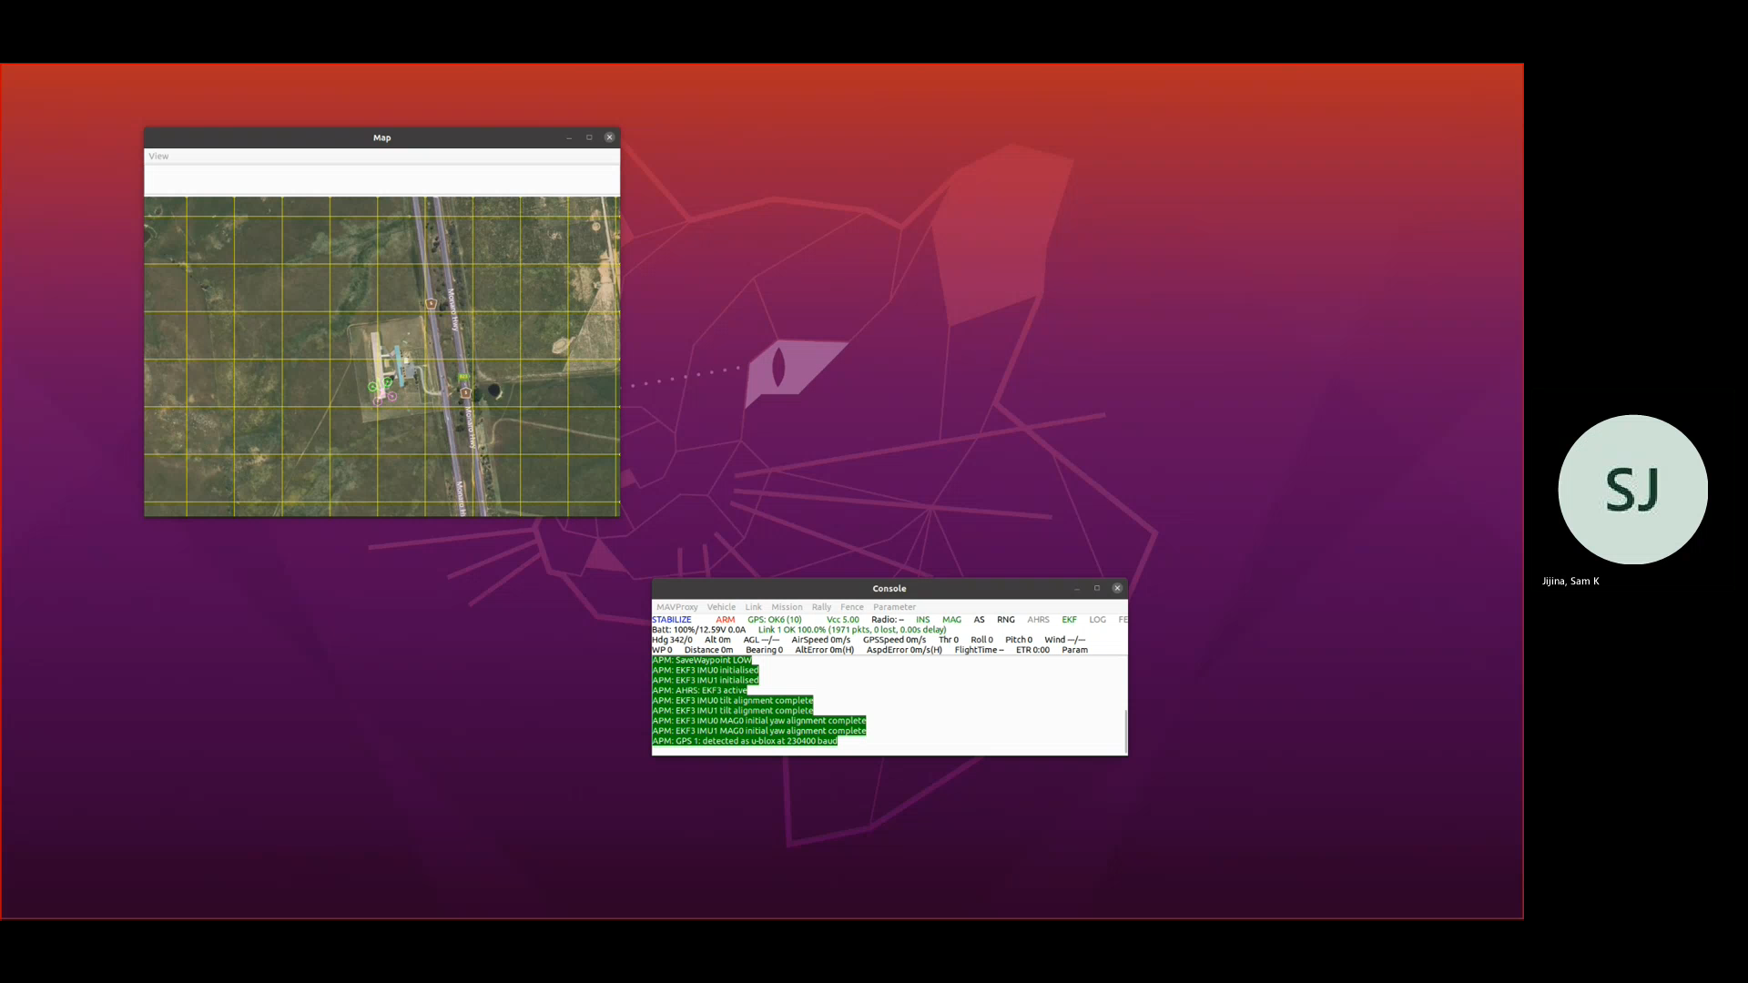
SITL Simulation Demo

Slide 21
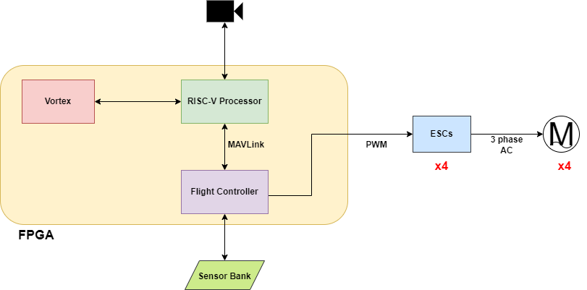
Vortex + Drone (1)
Heterogenous UAV Stack

Slide 22
Vortex + Drone (2)
Vortex accelerator for UAV stack
Rapid processing of video frames
Custom ML modelling
Flight controller (FC) frequency approx. 200MHz
Front end accelerated, flight controller bottleneck?
Exploring processor reliability for RISC-V based FC
Standard MAVLink comm. protocol
ESC profiling and design
HITL Simulation using Microsoft AirSim

Slide 23
Thank You

Slide 25
References
https://www.businessinsider.com/commercial-uav-market-analysis
https://medium.com/remote-sensing-in-agriculture/how-drone-technology-can-be-leveraged-in-agriculture-54b687c6dc45 (Slide 2)
https://www.steamboatpilot.com/news/the-sky-is-the-limit-routt-county-invests-in-drone-technology-for-law-enforcement-and-wildfires-as-legal-groups-worry-about-becoming-a-surveillance-society/ (Slide 2)
http://blog.jammer-store.com/2012/05/police-of-victoria-australia-will-use-flying-spy-drones/ (Slide 2)
https://www.dji.com/matrice-200-series
https://www.amazon.com/Amazon-Prime-Air/b?ie=UTF8&node=8037720011
https://store.dji.com/?gclid=Cj0KCQiA4sjyBRC5ARIsAEHsELFkQcKySwGljteaiXuFpDptFahOJOMxK9aHhbYcHsh5E-mlrKLn-zIaAmqSEALw_wcB
parrot.com
skydio.com
boeing.com/defense
https://www.lockheedmartin.com/en-us/capabilities/autonomous-unmanned-systems.html
bitcraze.io
https://www.dronaaviation.com/plutox/
https://arxiv.org/abs/1502.00956
opencv.org
emlid.com/navio2
pixhawk.org
raspberrypi.org
https://docs.emlid.com/navio2/ardupilot/typical-setup-schemes/(Slide 10)
ardupilot.org/planner
ardupilot.org/copter
mavlink.io
dronekit.io
ros.org
linux.org
https://dl.djicdn.com/downloads/inspire_1/en/Firmware_Update_Guide_en_v1.4.pdf
https://github.com/microsoft/AirSim
https://www.support.com/how-to/how-to-use-the-camera-for-a-dji-spark-drone-11760
https://www.amazon.com/gp/product/B00N3I9GM4/ref=ppx_yo_dt_b_asin_title_o05_s01?ie=UTF8&psc=1
https://docs.px4.io/v1.9.0/en/flight_controller/pixhawk3_pro.html
https://tipsfordrones.com/can-drones-fly-in-rain/
Notes:
**Fix this

